Slide 1



José Miguel González

Slide 2
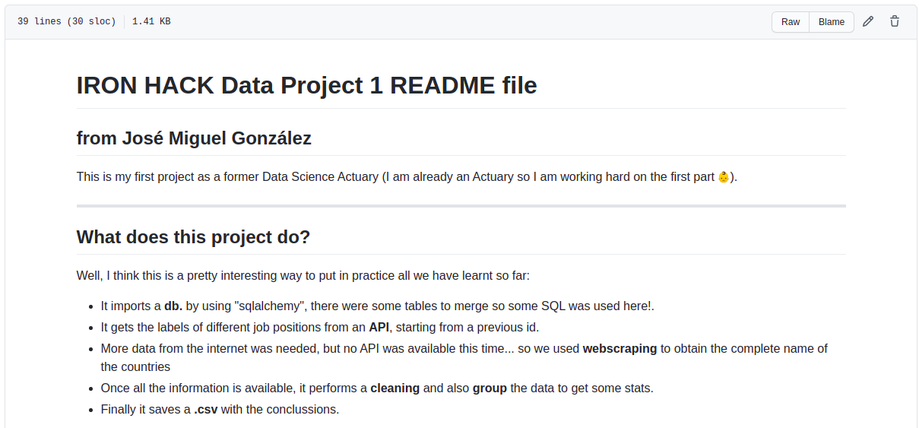

Slide 3
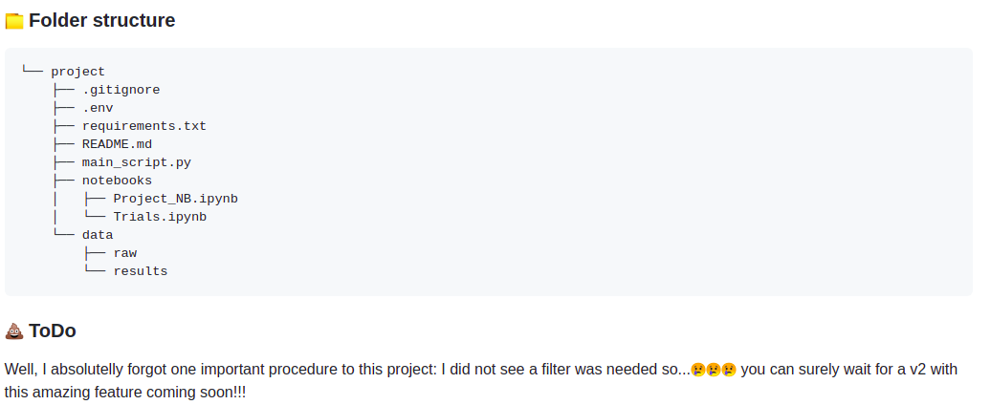

The followed structure:

Slide 4
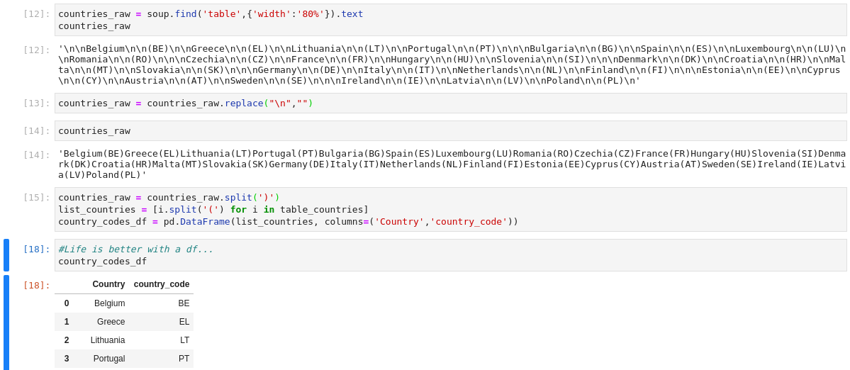

Not the most elegant, but maybe the most villain...

